Slide 1


Slide 2
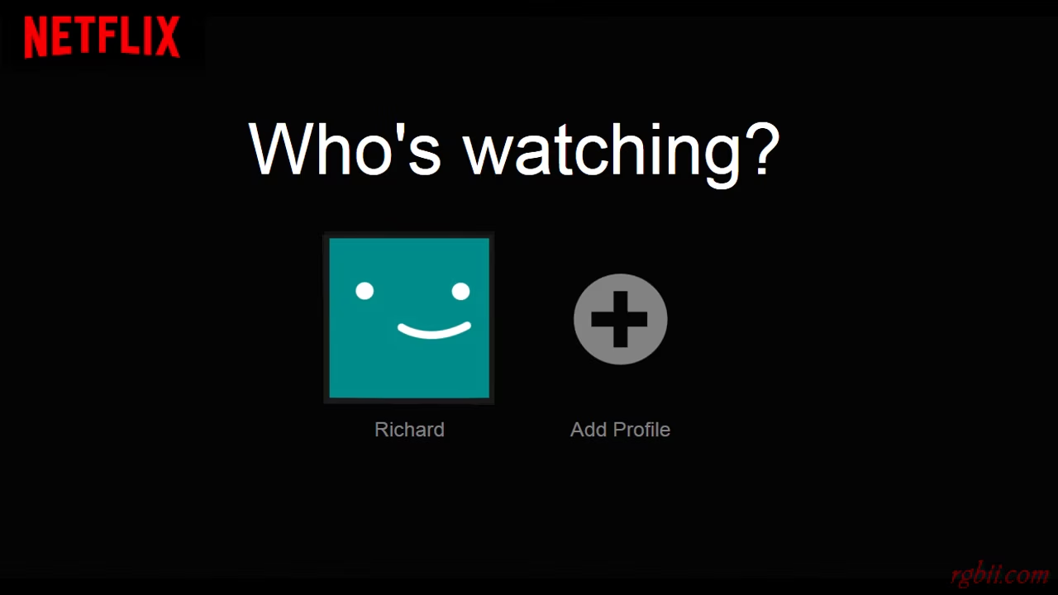
Kushal

Slide 3
CONTENTS
OVERVIEW
HR Transformation
Employee Development & Retention
Talent Acquisition
Course Concepts
Areas for Improvements
Alternative Strategies
03

Slide 4

OVERVIEW
Founded in 1997 by Reed Hastings and Marc Randolph
Initially offered rentable DVDs
Introduced subscription service for unlimited DVD rentals
Expanded globally by 2016
Emphasizes original content creation
Invests in localizing content for diverse markets
Offers features like offline viewing, multiple user profiles, and personalized recommendations
04
Notes:
Media company founded in 1997 by American entrepreneurs Reed Hastings and Marc Randolph as a way to offer movie rentals over the internet
initially provided consumers with a library of rentable DVDs
Added a subscription service, allowing customers unlimited DVD rentals.
By 2016, Netflix was accessible worldwide. The company continued to create more original content and pressed to grow its membership with its exclusive offerings.
invests heavily in localizing content and tailoring its offerings to different markets, allowing it to attract a diverse audience worldwide.
In addition to on-demand streaming, Netflix also provides features like offline viewing, multiple user profiles, and personalized recommendations based on viewing history and preferences
I

Slide 5

HR TRANSFORMATION
Emphasizes "freedom and responsibility" in its culture
Trusts employees and promotes high performance
Fosters a dynamic environment with minimal bureaucracy
Encourages innovation and calculated risks
Values employee opinions and creativity
Unconventional HR strategies, such as unlimited vacation time
Uses ongoing feedback and coaching instead of formal reviews
05
Notes:
Built around the concept of "freedom and responsibility," emphasizing trust in employees and a culture of high performance.
focuses on fostering a dynamic environment
minimal rules and bureaucracy, allowing individuals to innovate and take calculated risks. Employees are encouraged to voice their opinions, challenge ideas, and pursue creative solutions without fear of micromanagement
HR strategies are often unconventional.
Offers unlimited vacation time, trusting employees to manage their own schedules responsibly.
Abolished formal performance reviews in favor of ongoing feedback and coaching conversations, enabling continuous improvement

Slide 6



Employee Development & Retention
Shift from traditional performance reviews to informal 360-degree reviews
Emphasis on frequent feedback and honest communication
Impact on employee satisfaction and retention rates
START
STOP
CONTINUE
06
Notes:
First, they split into pairs and gave each other feedback.
They used the “start, stop and continue” format to give each other feedback. The “start, stop, and continue” feedback format consists of three key questions which are 1)what will you start doing that you are not currently doing? 2)what will you stop doing that you are currently doing? 3)What will you continue to do that you are already doing?
After the paired-up feedback, they all got into a group to further discuss what they had learned from each other through the feedback.
Realized that traditional corporate performance reviews are driven by fear they were too ritualistic and too infrequent
Informal 360-degree reviews
Employees were asked to identify how co-workers could improve regularly.
The results were much better than a company that grades people on a 5-point scale.
Managers are trained to be honest with their employees
Frequent feedback
Employee Appreciation and Recognition
Furthermore, Netflix boasts an impressive employee retention rate of over 95%

Slide 7
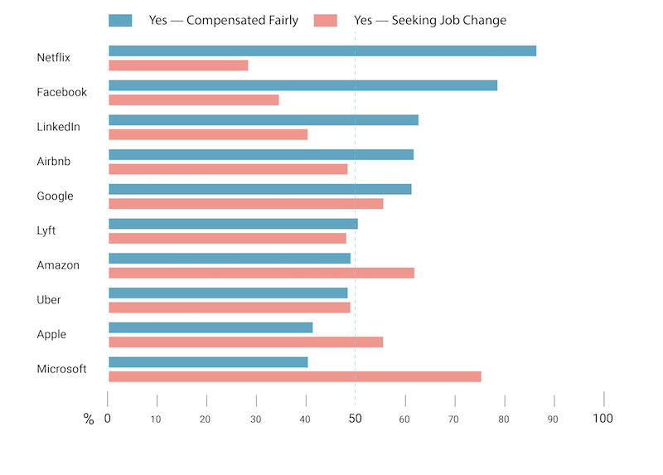
Compensation Satisfaction VS Job Change Interest
07

Slide 8


Netflix’s Job Performance Review
08

Slide 9


Talent Recruitment & Acquisition
“Culture of Recruitment” -Recruiters work with hiring managers.
Pathway Bootcamp- 12 week program for aspiring software engineers.
50% of all employees are from protected classes.
Employees have choice in time that have off.
Pay salaries at the top of the market rate.
09
Notes:
Recruiters and hiring managers work together to find the best fit. Instead of the recruiter throwing resumes at the hiring manager they take the time together to learn about the potential candidate and better understand how they would fit into the company. 12 week program for free teaches students how to be software engineers and gives them an interview at netflix and helps them find employment outside of it. They focus on hiring people from all different backgrounds. The culture of netflix gives the employees a lot of freedoms and say in decisions that makes them want to work at Netflix. They allow them to take as many days off as they want as long as they get their work done. They also give salaries that are at the top of the market to attract the best talent and give the workers a fair pay for all of their hard work and dedication.

Slide 10
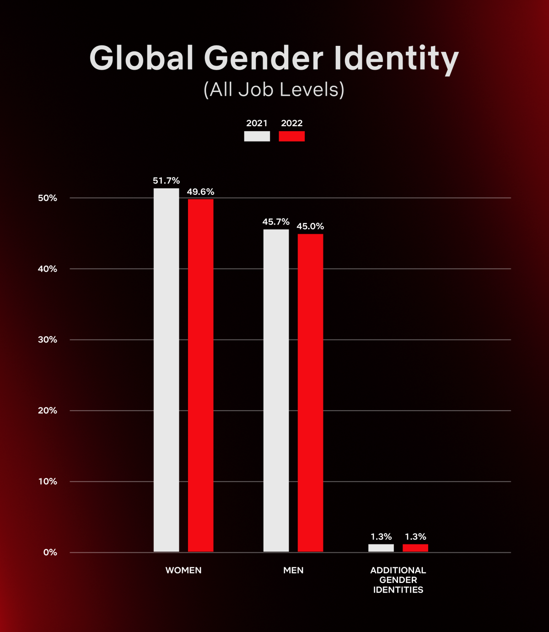
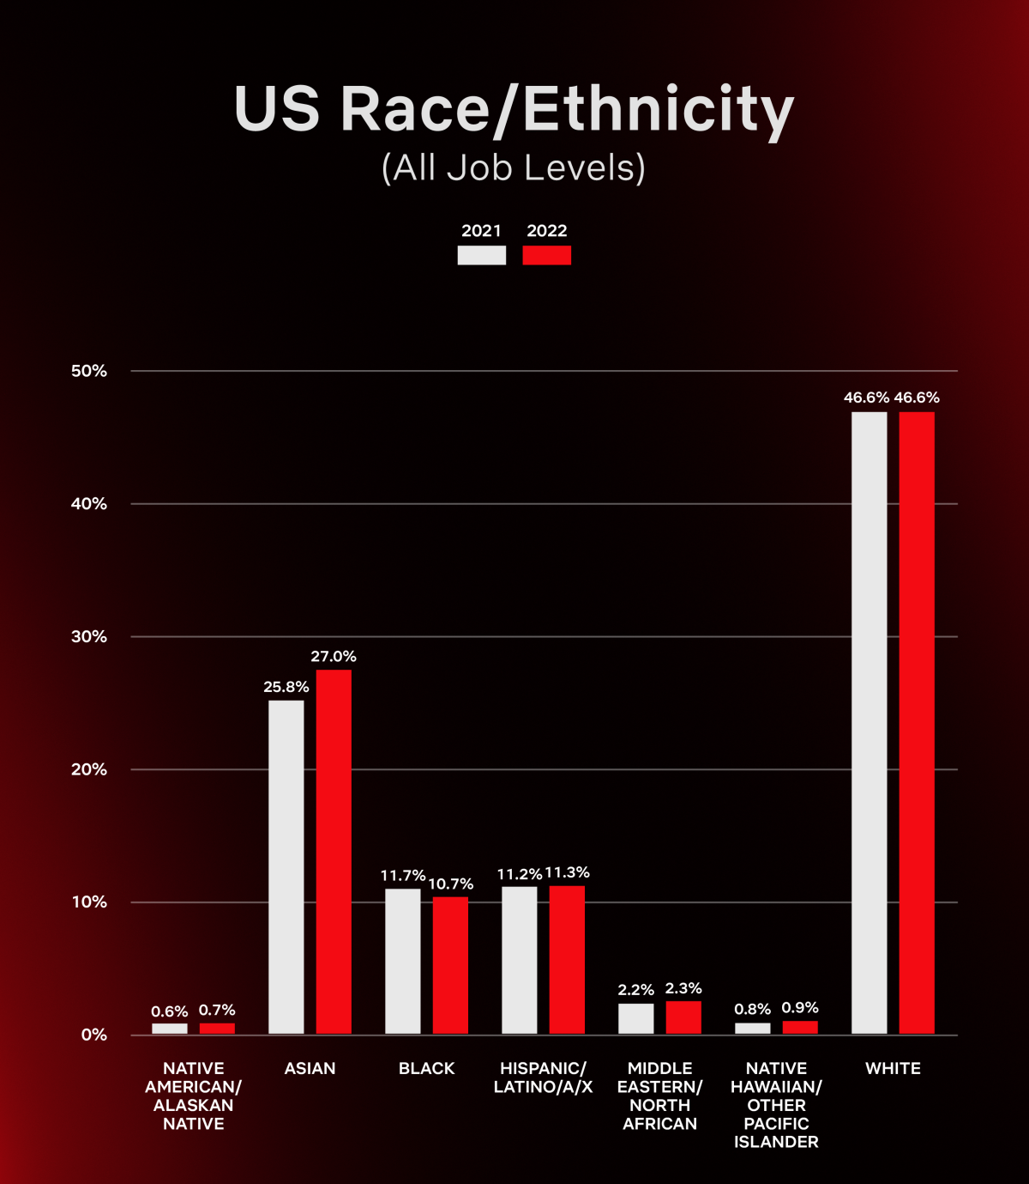
10

Slide 11






Application of HR Course Concepts
Employee Recruitment Retention & Job Peer Feedback Organization
Engagement Benefits Enrichment & Collaboration Culture
11

Slide 12

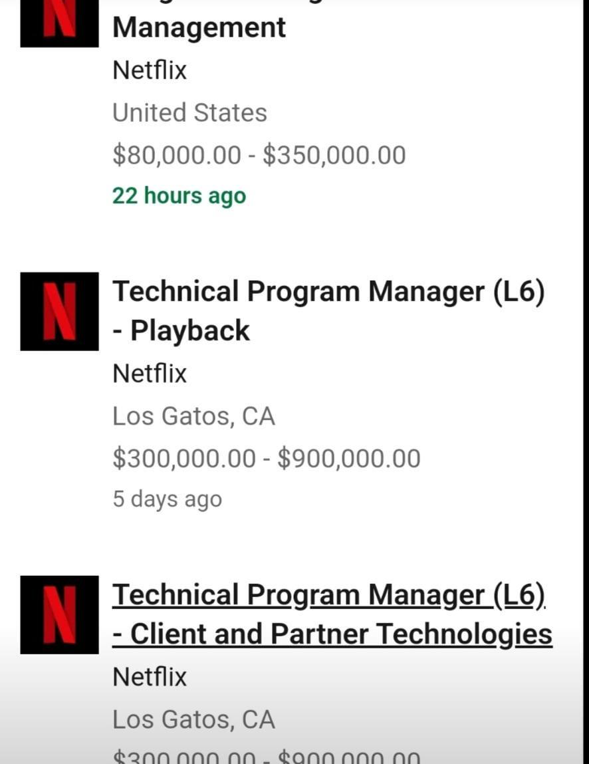

EMPLOYEE ENGAGEMENT
RECRUITMENT
RETENTION &
BENEFITS
12

Slide 13


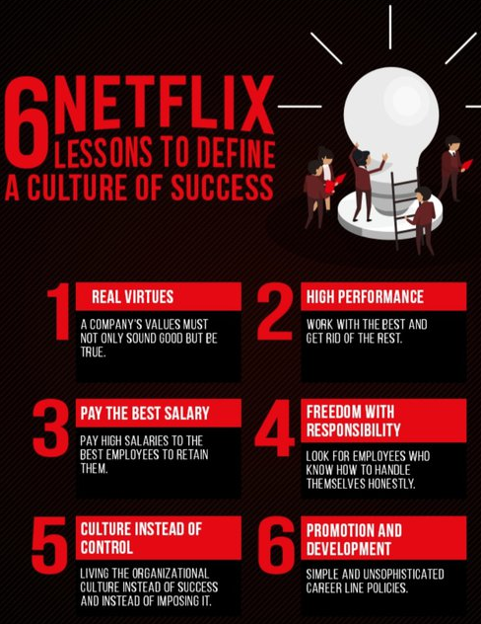
JOB ENRICHMENT
PEER
FEEDBACK
ORGANIZATION CULTURE
13
Notes:
Fostering a Culture of Freedom and Responsibility Netflix also places a strong emphasis on employee development and career growth. The company offers a variety of training and development opportunities, such as mentoring and coaching programs, to help employees advance in their careers.
Another way Netflix keeps its employees happy is by giving them a voice through regular surveys. The company conducts regular employee engagement surveys to gather feedback on various aspects

Slide 14
Areas for Improvement
Bonuses
Long-term incentives
Responsible for their own development
Harder to manage with growth
LEARN MORE
14

Slide 15

Alternative Strategies
Performance-Based Recognition
Investment in Learning and Development Resources
Transparent Career Development Paths
Scalable HR Processes
15

Slide 16
THANK YOU
16

Slide 17
Citations
https://www.shrm.org/topics-tools/news/hr-magazine/tough-love-netflix#:~:text=Netflix%20has%20a%20controversial%20tough,responsible%20for%20their%20own%20development
https://hbr.org/2014/01/how-netflix-reinvented-hr
https://www.thehumancapitalhub.com/articles/netflix-human-resources-what-you-need-to-know
https://business.linkedin.com/talent-solutions/case-studies/tech/netflix
17

